Slide 1

The future of research communication and evaluation:
An interactive thought experiment
Marino van Zelst (Twitter, GitHub, Email)
Dept. of Organization Studies, Tilburg University

Slide 2
Redesigning the publication system
Themes of today’s Metascience workshops:
Funding practices, open science, reproducibility, replication
All of these issues are linked through:
1) how we communicate research
2) how we evaluate research(ers)
Goal of today: develop critical thinking of how we ‘science’

Slide 3
Functions of the current publication system
Function
Registration
Certification
Awareness
Archiving
Rewarding
Adapted from Hartgerink (2018)

Slide 4
Studies conducted
Published = statistically significant + consistent
Not pub = statistically significant + inconsistent
Not pub = statistically nonsignificant + consistent
Not pub = statistically nonsignificant + inconsistent
Not pub = genuine design mistake

Slide 5
Functions of the current publication system
Function | Narrow vision (current)
Registration | Select works are registered
Certification | Peer judgment (including bias)
Awareness | Some can access outputs
Archiving | Dark archives
Rewarding | Perverse incentives
Adapted from Hartgerink (2018)

Slide 6
A Theory of Justice (John Rawls, 1971)
In ‘the original position’, the parties select principles that will determine the basic structure of the society they will live in.
Structure: distribution of skills, positions, and resources

Slide 7
A Theory of Justice (John Rawls, 1971)
In ‘the original position’, the parties select principles that will determine the basic structure of the society they will live in.
Structure: distribution of skills, positions, and resources
Parties select principles with a ‘veil of ignorance’

Slide 8
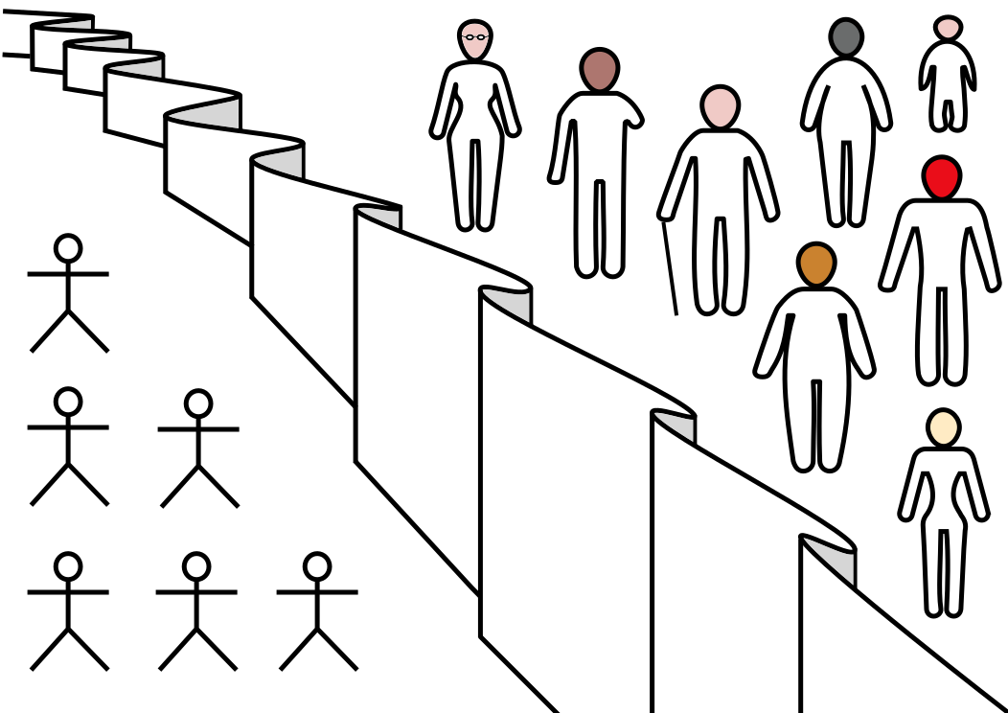
‘Veil of ignorance’

Slide 9
A Theory of Justice (John Rawls, 1971)
In ‘the original position’, the parties select principles that will determine the basic structure of the society they will live in.
Structure: distribution of skills, positions, and resources
Parties select principles with a ‘veil of ignorance’
Rawls conclusion: Leads to adoption of ‘maximin rule’ as design principle

Slide 10
Redesigning research communication and research evaluation
And consequentially, the entirety of academia?
The rest of this workshop is about designing research communication and research evaluation using ‘the original position’ as a starting point

Slide 11
Principles of the redesign
You want to participate in the ‘academic society’
You want to contribute to better science
You are completely unaware of your scientific skills
Rewards and resources need to be distributed in some way

Slide 12
Assignment
How do we communicate how we ‘scienced’?
How do we evaluate research(ers)?
Keep in mind:
  You have no clue what your own skills are, but you want to ‘survive’
  The five functions of a publication system

Slide 13
A future of the publication system?
Function | Narrow vision (current) | Wider vision
Registration | Select works are registered | All research outputs are registered
Certification | Peer judgment (including bias) | Process + peer judgment (minus bias)
Awareness | Some can access outputs | All can access outputs
Archiving | Dark archives | Live archives
Rewarding | Perverse incentives | Incentives promote rigorous results
Adapted from Hartgerink (2018)

